Slide 1
Software Development Environment
Zynq
Vivado 2015.2 Version

Slide 2
Outline
Desktop vs. Embedded
Software Development Tools
Software Development with SDK
Library Generation
Address Management
Linker Script

Slide 3
Desktop versus Embedded
Desktop development: written, debugged, and run on the same machine
OS loads the program into the memory when the program has been requested to run
Address resolution takes place at the time of loading by a program called the loader
The loader is included in the OS
The programmer glues into one executable file called ELF
Boot code, application code, RTOS, and ISRs
Address resolution takes place during the gluing stage
The executable file is downloaded into the target system through different methods
Ethernet, serial, JTAG, BDM, ROM programmer

Slide 4
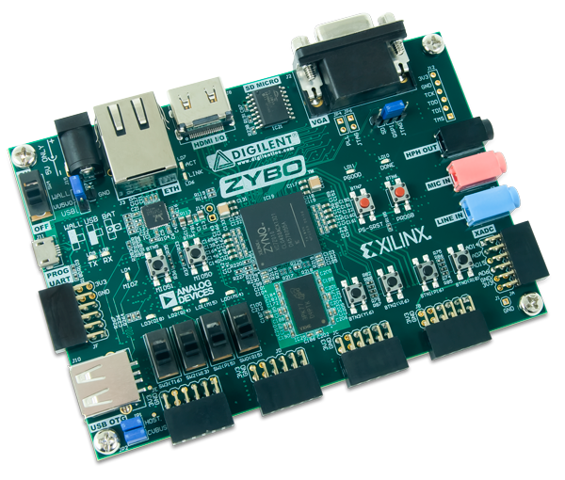
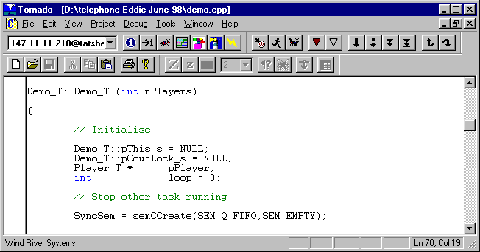
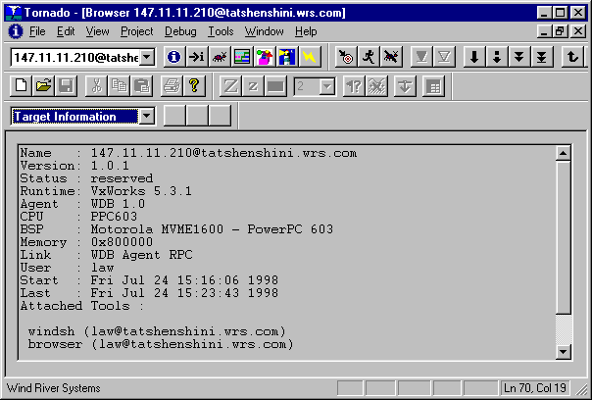
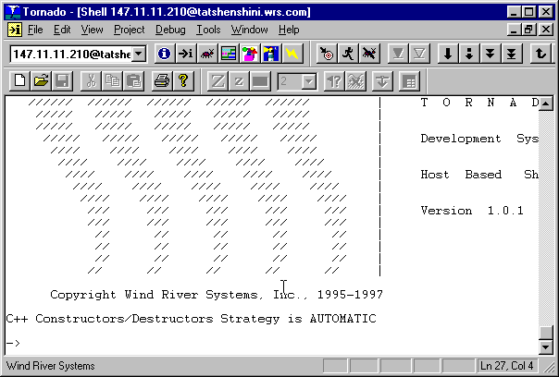
Embedded versus Desktop
Development takes place on one machine (host) and is downloaded to the embedded system (target)
JTAG
Host Computer
UART
A cross-compiler is run on the host
Target Board

Slide 5
Embedded Development
Different set of problems
Unique hardware for every design
Reliability
Real-time response requirement (sometimes)
RTOS versus OS
Code compactness
High-level languages and assembly
Notes:
Every embedded system design is unique in its function and targeted for a unique application. A design developed for one application may not work for another embedded system. Another issue is reliability. Because the system is standalone, and a combination of hardware and software, the design may have some hidden bugs that can make the system malfunction. Therefore, such a system may not be one hundred percent reliable. Depending on the application, the system may require real-time response and RTOS use, which can lead to bigger code and a larger memory requirement. Real-time systems also require assembly language programming for time-critical applications.

Slide 6
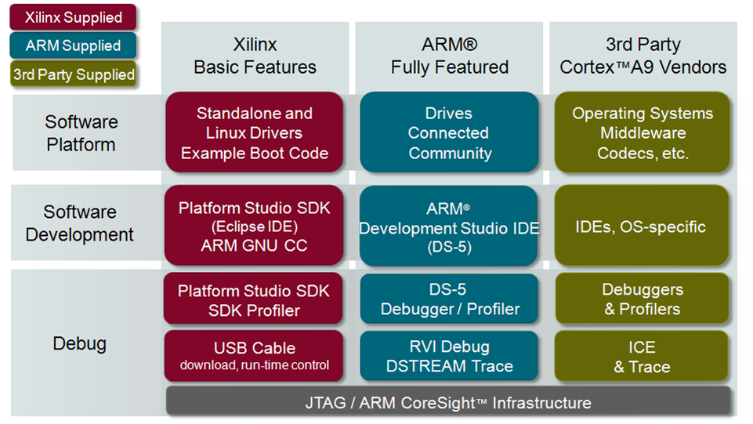
Software Development Tools

Slide 7
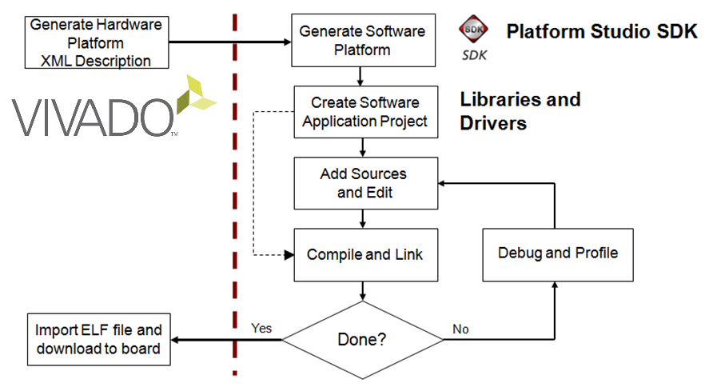

SDK Application Development Flow

Slide 8
Launching SDK
Launch SDK
Standalone
Choose workspace, choose Hardware Platform Specification
In Vivado
File> Export Hardware
File > Launch SDK
Exporting
A Hardware Description File HDF file is first generated
A hardware platform specification project is then automatically created
The software application (and board support package) then can be created and associated with the hardware platform

Slide 9
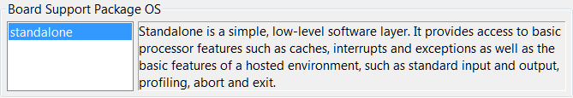
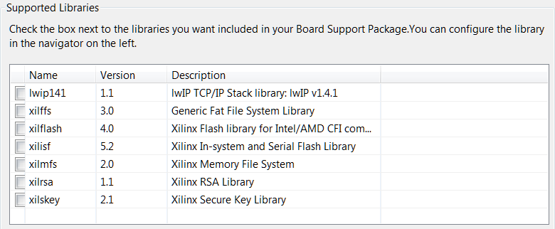

Creating a Board Support Package
The Board Support Package provides software services based on the processor and peripherals that make up the processor system
Can be automatically created when creating Application project
Can be created standalone
Must be attached to a Hardware Platform
File > New > Board Support Package
Select appropriate OS support
Third-party operating systems are supported with the appropriate BSP selection
Select required libraries support

Slide 10
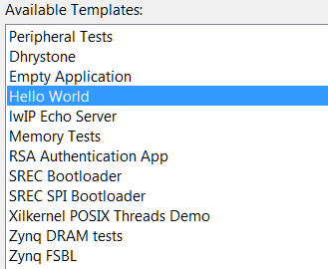
Creating a Software Application Project
SDK supports multiple software application projects
A software project is attached to a BSP project
Sample applications are provided
Great for quick test of hardware
Peripheral Tests
Starting point to base your own application on
Typically an Empty Application is opened to begin a non-standard project

Slide 11
Embedded Tool Flow (SDK)
SDK
Library Generation
Hardware
Platform Generation
Simulation
Generator
IPI
CompXLib
MSS
IP Models
HDL Models
IP Library or User Repository
SW Libraries
Library Generation
Drivers
.hdf
Platform Generation
Simulation model
Generation
.a
Libraries,
OS, MLD
HDL
System and Wrapper HDL
system.bmm
Behavioral VHD Model
Embedded Software
Development
Synthesis
Application Source .c, .h, .s
Simulation model
Generation
Compiler (GCC)
XDC
Implementation
Structural/Timing VHD Model
.o, .a
Linker Script
Linker (GCC)
system_bd.bmm
Bitstream Generation
Simulation model
Generation
ELF
Configure BRAM
system.bit
Structural/Timing VHD Model
XMD, TCF GDB
download.bit
Hardware Manager
Simulation
JTAG Cable
FPGA

Slide 12
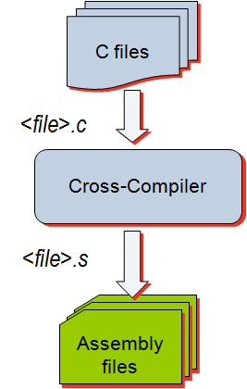
GNU Tools: GCC
GCC translates C source code into assembly language
GCC also functions as the user interface to the GNU assembler and to the GNU linker, calling the assembler and the linker with the appropriate parameters
Supported cross-compilers:
GNU GCC (arm-xilinx-eabi-gcc)
Command line only; uses the settings set through the GUI

Slide 13
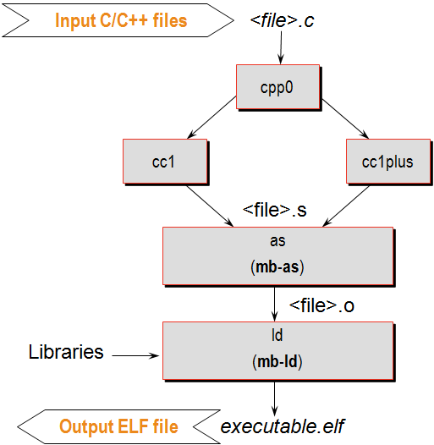
GNU Tools: GCC
Calls four different executables
Preprocessor (cpp0)
Replaces all macros with definitions defined in the source and header files
Language specific c-compiler
cc1 C-programming language
cc1plus C++ language
Assembler
arm-xilinx-eabi-as
Linker
arm-xilinx-eabi-ld
arm-xilinx-eabi-as
arm-xilinx-eabi-ld

Slide 14
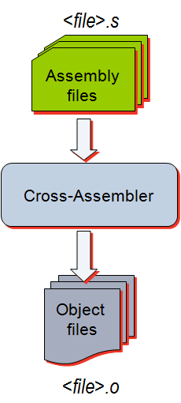
GNU Tools: AS
Input: Assembly language files
File extension: .s
Output: Object code
File extension: .o
Contains
Assembled piece of code
Constant data
External references
Debugging information
Typically, the compiler automatically calls the assembler
Use the -Wa switch if the source files are assembly only and want to use the gcc

Slide 15
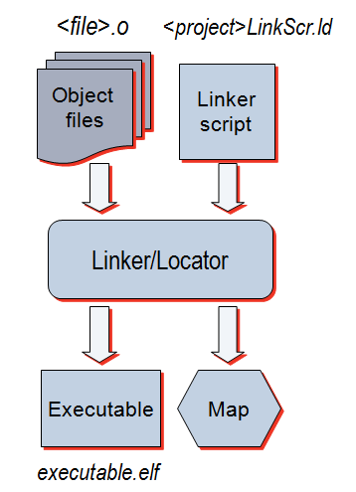
GNU Tools: LD
Linker
Inputs:
Several object files
Archived object files (library)
Linker script (mapfile)
Output:
Executable image (.ELF)
Map file

Slide 16
GNU Utilities
AR Archiver
Create, modify, and extract from libraries
Used in SDK to combine the object files of the Board Support Package (BSP) in a library
Used in SDK to extract object files from different libraries
Object Dump
Display information from object files and executables
Header information, memory map
Data
Disassemble code
The mb-objdump (powerpc-eabi-objdump) utility lets you see the contents of an object (.o) or executable (.out) file.
To see your symbol table, the size of your file, and the names or sizes of the sections in the file, run:
mb-objdump -x a.out
To see a listing of the (assembly) code in your object or executable file, run:
mb-objdump -d a.out
To get a list of other options, run:
mb-objdump --help
Notes:
The mb-objdump (powerpc-eabi-objdump) utility lets you see the contents of an object (.o) or executable (.out) file.
To see your symbol table, the size of your file, and the names or sizes of the sections in the file, run:
mb-objdump -x a.out
To see a listing of the (assembly) code in your object or executable file, run:
mb-objdump -d a.out
To get a list of other options, run:
mb-objdump --help

Slide 17
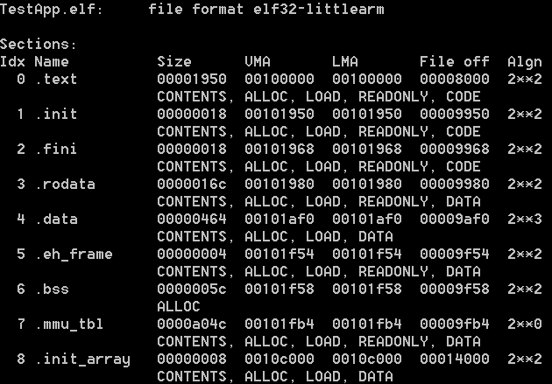
Object Dump Display summary information from the section headers
arm-xilinx-eabi-objdump –h executable.elf
Section
Name
Byte alignment
Virtual Memory Address
Loadable Memory Address
Section Size
Offset from the beginning of the section header table

Slide 18
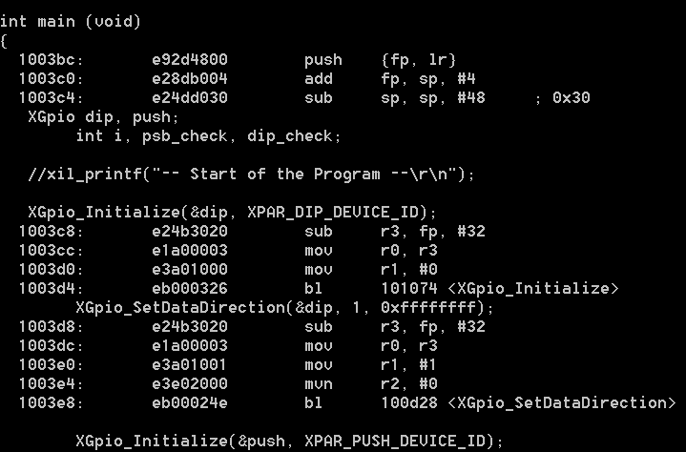
Object Dump Dumping the source and assembly code
arm-xilinx-eabi-objdump –S executable.elf
Memory location
C code instruction
Assembly instruction
Machine Language Instruction

Slide 19
Minimal Required Services
C language standard services
C language construct services
stdin and stdout
Math library
malloc
Processor support requires these services
Interrupt
Cache
Language environment support

Slide 20
Operating Systems
Operating systems are a collection of software routines that comprise a unified and standard set of system services
The Standalone option is used when no operating system is desired
Provides a minimal amount of processor and library services as previously illustrated
Can be considered a minimal, non-standard operating system
Installed as a software platform
Variety of third-party operating systems are available
Linux – many flavors
RTOS – real-time operating system; also has many flavors; Free RTOS (an option for the Cortex™-A9 processor)
XilKernel – provided by Xilinx; small and simple; only for MicroBlaze
Operating systems are installed and become part of the Board Support Package (BSP)

Slide 21
What an Operating System Provides?
Operating system services
GUI support
TCP/IP services**
Task management
Resource management**
Familiar programming services and tasks
Easy connection to already written applications
Ability to reload and change applications
Full file system services**
** Also available as additions to the Standalone BSP

Slide 22
Do I Need an Operating System?
The Standalone BSP includes the previously discussed items
Design considerations for systems using the Standalone BSP
All services needed are included in the BSP
The application is static—it never changes
The application fits in block RAM (MicroBlaze™ processor), OCM RAM (Zynq™ AP SoC), or DDR memory
The application is single-task based
Interrupts may or may not be used

Slide 23
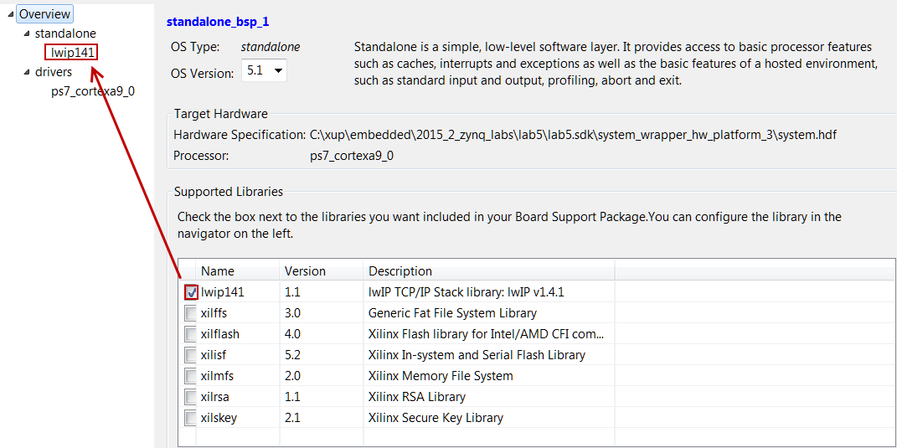
Accessing Software Platform Properties
Select the created board support package in the Project Explorer view
Xilinx Tools > Board Support Package Settings
Sets all of the software BSP related options in the design
Has multiple forms selection
Overview
Standalone
Drivers
CPU
As individual Standalone services are selected a configurable menu selection item will appear
Notes:
Open the Software Platform Settings dialog box by selecting Tools → Software Platform Settings. This dialog box has multiple forms and is used to set all the software platform-related options in the design.
Overview:
This form allows you to select the OS version and services.
You can also select available libraries support in this form. Depending on the library that you select in this form, a configuration panel menu selection will appear under the Standalone menu.
Standalone:
This form shows a list of all configurable devices (stdin/stdout). You can also select if you want to perform profiling and a timer to be used in profiling. If any library support is selected in the Overview form, and menu of the service’s configurable parameters will be presented under the Standalone menu.
Drivers:
This form allows you to specify values for the parameters associated with the peripheral drivers in the design.
CPU:
Tool chain options and their settings.

Slide 24
Embedded Tool Flow (SDK)
Library Generation
Hardware
Platform Generation
Simulation
Generator
IPI
CompXLib
MSS
IP Models
HDL Models
IP Library or User Repository
SW Libraries
Library Generation
Drivers
.hdf
Platform Generation
Simulation model
Generation
.a
Libraries,
OS, MLD
HDL
System and Wrapper HDL
system.bmm
Behavioral VHD Model
Embedded Software
Development
Synthesis
Application Source .c, .h, .s
Simulation model
Generation
Compiler (GCC)
XDC
Implementation
Structural/Timing VHD Model
.o, .a
Linker Script
Linker (GCC)
system_bd.bmm
Bitstream Generation
Simulation model
Generation
ELF
Configure BRAM
system.bit
Structural/Timing VHD Model
XMD, TCF GDB
download.bit
Hardware Manager
Simulation
JTAG Cable
FPGA

Slide 25
Library Generation Flow (in SDK)
Input files → MSS
Output files → libc.a, libXil.a, libm.a
Library generator is generally the first tool run to configure libraries and device drivers
The MSS file defines the drivers associated with peripherals, standard input/output devices, and other related software features
Library generator configures libraries and drivers with this information and produces an archive of object files:
libc.a - Standard C library
libXil.a - Xilinx library
libm.a - Math functions library
Notes:
Software Files
MSS
An MSS file is supplied by the user as an input to the Library Generator (LibGen). The MSS file contains directives for customizing operating systems, libraries, and drivers
Linker script
The linker script describes the mapping among all the sections in all the input object files and the output executable file. This file is used by the GNU linker
Base System Builder will create a linker script for you
If your address map specifies that the LMB, OPB, and external memory occupy contiguous areas of memory, you can use the BSB-created linker script to generate your executable
C/C++ source files
Source code and header files written by the user

Slide 26
Address Management
Embedded processor design requires you to manage the following:
Address map for the peripherals
Location of the application code in the memory space
Block RAM
External memory (Flash, DDR3, SRAM)
Memory requirements for your programs are based on the following:
The amount of memory required for storing the instructions
The amount of memory required for storing the data associated with the program

Slide 27
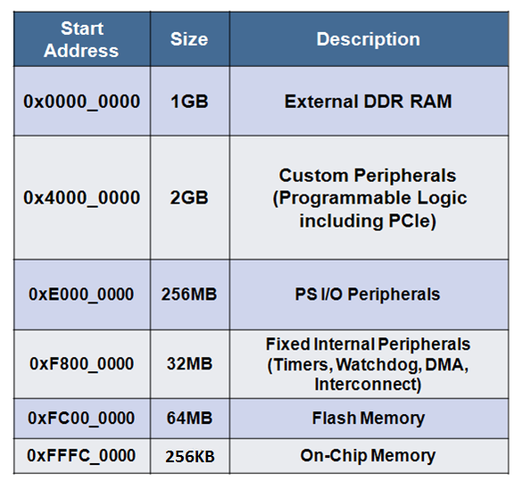
Standard ARM Programming Model
Processing system and programmable logic look the same
AMBA® and AXI interfaces
Memory-mapped I/O
Register access
Consistency for PS and PL = ease of use
Memory map usage: total of 4 GB
1 GB: DDR RAM
2 GB: dedicated to PL peripherals
1 GB: PS peripherals, OCM, external flash

Slide 28
Linker Script
Linker script controls the linking process
Map the code and data to a specified memory space
Set the entry point to the executable
Reserve space for the stack
Required if the design contains a discontinuous memory space

Slide 29
Linker and Locator Flows
foo1.o
Executable Image
Merged Output Sections
0xFFFF
.text1
Code
.data1
0xF000
.text
Locate
.bss1
0xEFFF
Link
.data
uninitialized data
0xEF00
foo2.o
0xEEFF
.bss
Unused
.text2
0x2000
.data2
0x1FFF
Initialized data
.bss2
0x0000

Slide 30
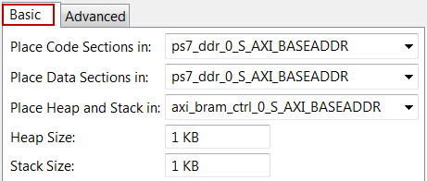
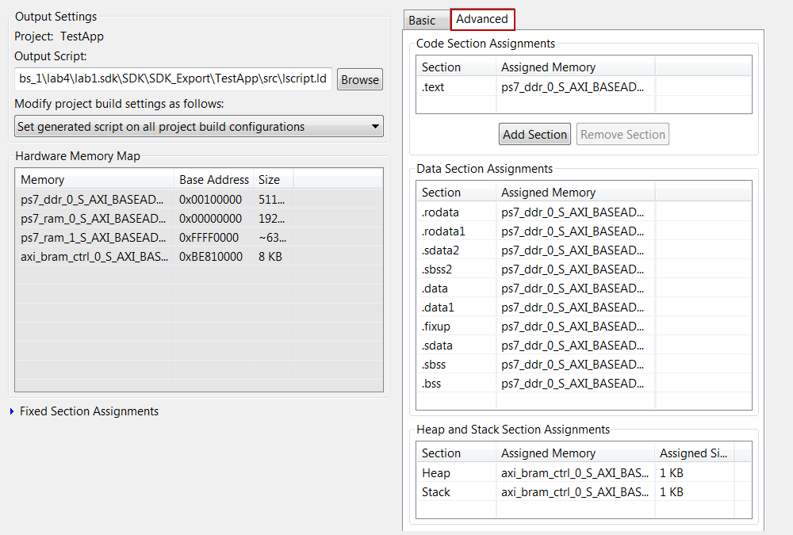
Linker Script Generator GUI
Table-based GUI allows you to define the memory space for code and data sections
Launch from Xilinx Tools > Generate Linker Script, or from the C/C++ perspective, right-click on <project> > Generate Linker Script
The tool will create a new linker script (the old script is backed up)

